Slide 1
Raytracing
Dr. Rafael Kuffner dos Anjos

Slide 2
Agenda
Rendering Equation
Implementation steps

Slide 3

Rendering Equation
The answer according to physics
A single equation that captures all light
We will then have to convert it to code
But the idea is pretty simple
We will, however, need some assumptions

Slide 4
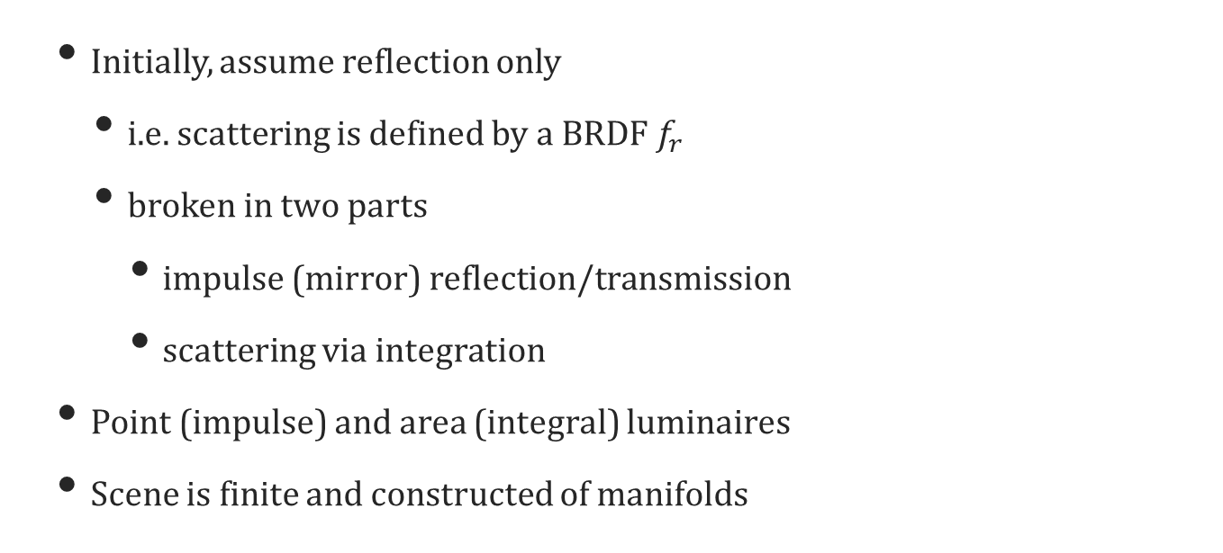
Assumptions
Initially, assume reflection only
i.e. scattering is defined by a BRDF $f_{r}$
broken in two parts
impulse (mirror) reflection/transmission
scattering via integration
Point (impulse) and area (integral) luminaires
Scene is finite and constructed of manifolds

Slide 5
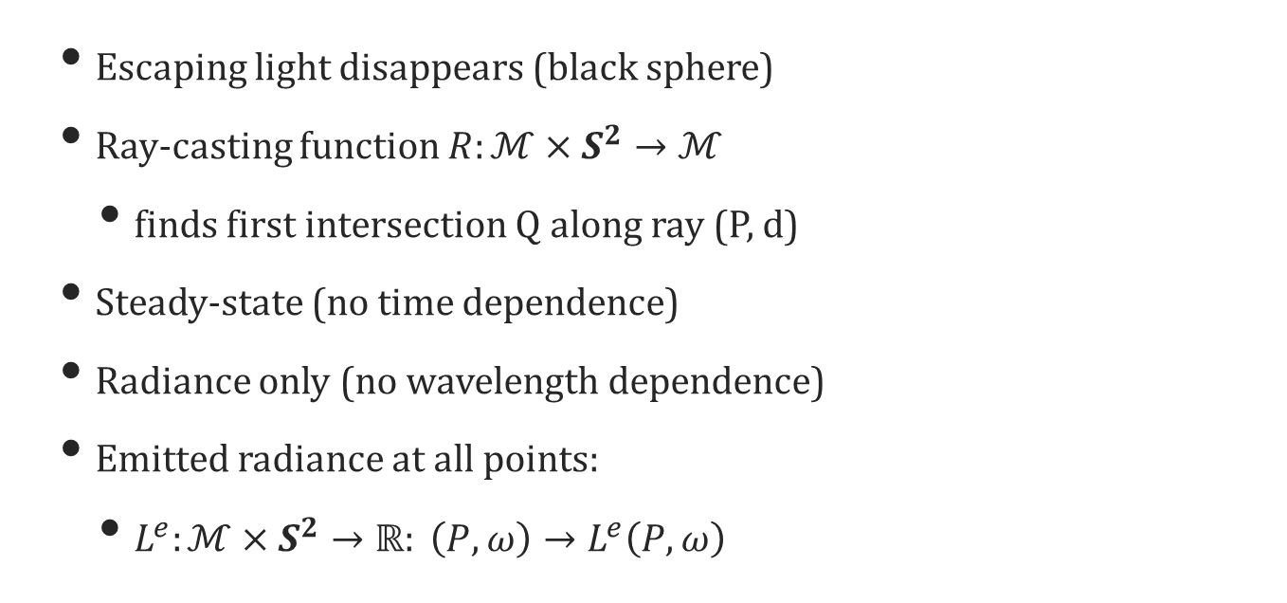
More Assumptions
Escaping light disappears (black sphere)
Ray-casting function $R:ℳ×S^{2}→ℳ$
finds first intersection Q along ray (P, d)
Steady-state (no time dependence)
Radiance only (no wavelength dependence)
Emitted radiance at all points:
$L^{e}:ℳ×S^{2}→ℝ: \left(P,ω\right)→L^{e}\left(P,ω\right)$

Slide 6
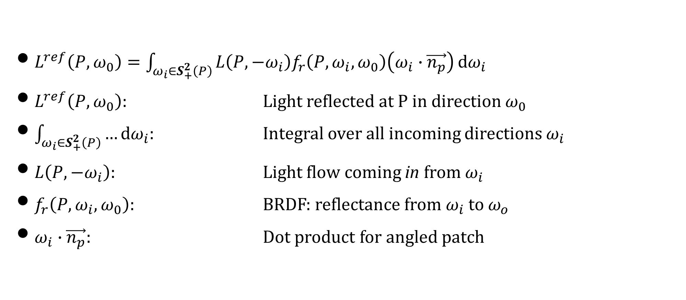
Rendering Equation
$L^{ref}\left(P,ω_{0}\right)=\int_{ω_{i}∈S_{+}^{2}\left(P\right)}^{ }{L\left(P,−ω_{i}\right)f_{r}\left(P,ω_{i},ω_{0}\right)\left(ω_{i}∙\vec{n_{p}}\right)}\text{d}ω_{i}$
$L^{ref}\left(P,ω_{0}\right)$: Light reflected at P in direction $ω_{0}$
$\int_{ω_{i}∈S_{+}^{2}\left(P\right)}^{ }{…}\text{d}ω_{i}:$ Integral over all incoming directions $ω_{i}$
$L\left(P,−ω_{i}\right):$ Light flow coming in from $ω_{i}$
$f_{r}\left(P,ω_{i},ω_{0}\right)$: BRDF: reflectance from $ω_{i}$ to $ω_{o}$
$ω_{i}∙\vec{n_{p}}$: Dot product for angled patch

Slide 7
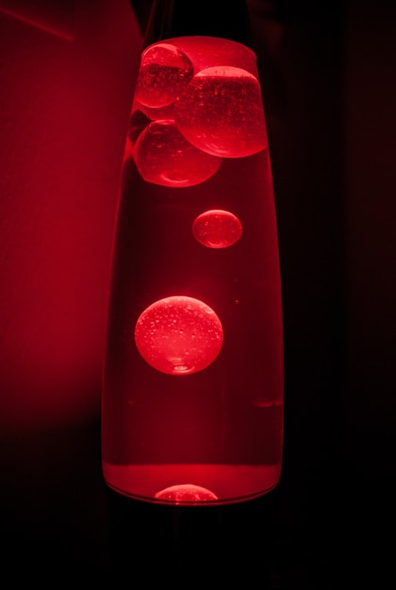
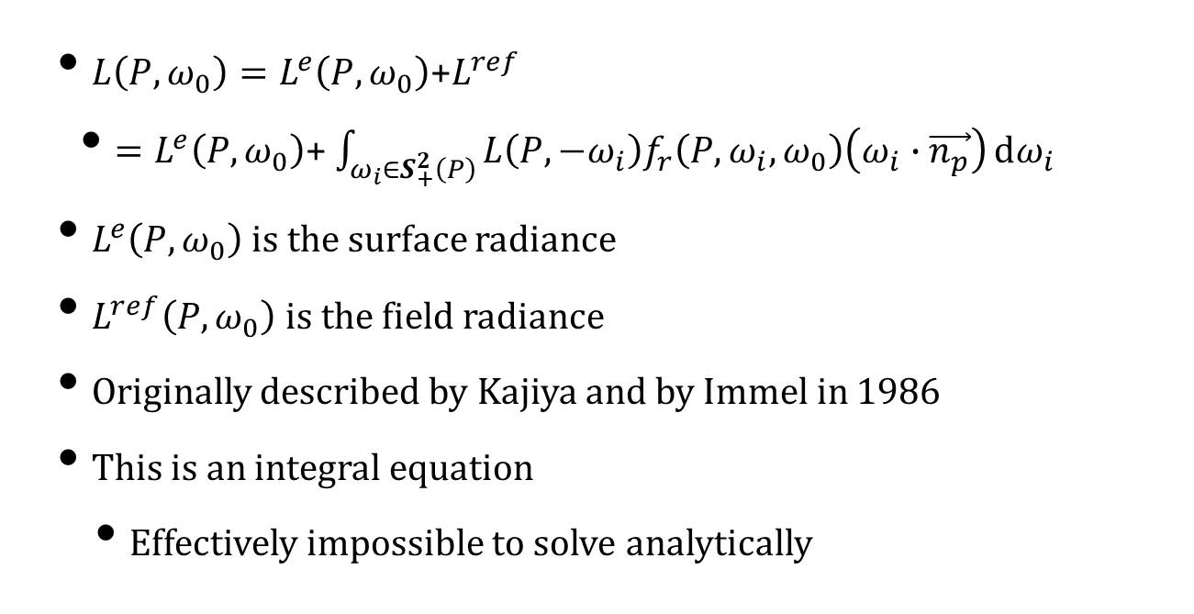
Adding Emission
$L\left(P,ω_{0}\right)=L^{e}\left(P,ω_{0}\right)$+$L^{ref}$
$=L^{e}\left(P,ω_{0}\right)$+ $\int_{ω_{i}∈S_{+}^{2}\left(P\right)}^{ }{L\left(P,−ω_{i}\right)f_{r}\left(P,ω_{i},ω_{0}\right)\left(ω_{i}∙\vec{n_{p}}\right)}\text{d}ω_{i}$
$L^{e}\left(P,ω_{0}\right)$ is the surface radiance
$L^{ref}\left(P,ω_{0}\right)$ is the field radiance
Originally described by Kajiya and by Immel in 1986
This is an integral equation
Effectively impossible to solve analytically

Slide 8
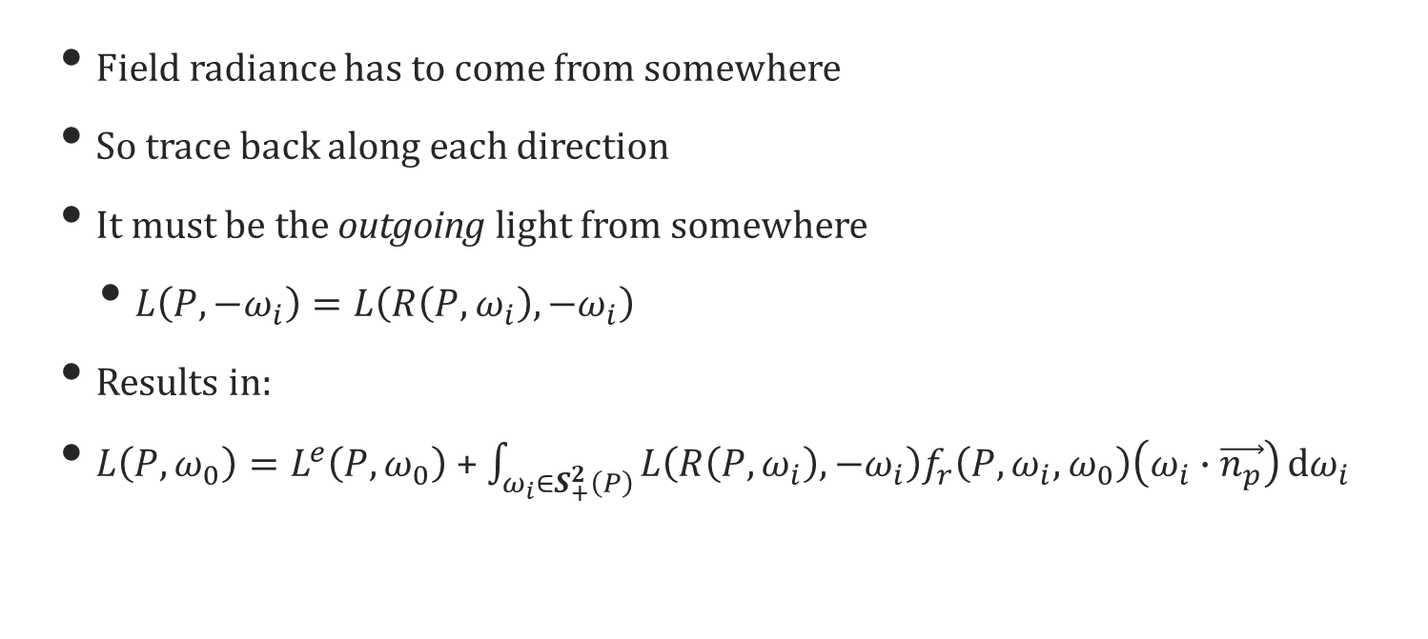
Transport Equation
Field radiance has to come from somewhere
So trace back along each direction
It must be the outgoing light from somewhere
$L\left(P,−ω_{i}\right)=L\left(R\left(P,ω_{i}\right),−ω_{i}\right)$
Results in:
$L\left(P,ω_{0}\right)=L^{e}\left(P,ω_{0}\right)$ + $\int_{ω_{i}∈S_{+}^{2}\left(P\right)}^{ }{L\left(R\left(P,ω_{i}\right),−ω_{i}\right)f_{r}\left(P,ω_{i},ω_{0}\right)\left(ω_{i}∙\vec{n_{p}}\right)}\text{d}ω_{i}$

Slide 9

Solving Computationally
For each ray (pixel)
Find first intersection along ray
On the first bounce, add emission
Add direct light from point (impulse) lights
Add direct light from area lights
Add indirect light from reflections

Slide 10
Surface Element Class

Slide 11
A Simple Raytracer

Slide 12
Path Trace Function

Slide 13
Lighting Functions

Slide 14
Intersection Problems
Intersection is a numerical test
So we might be off by a small epsilon
This causes issues with lighting
Solution: displace intersection
Small amount along normal vector
Assume this is done in the intersection code

Slide 15
Upgrading Direct Lighting
Test shadow ray from P to light source
If it intersects an object, no direct light
Add attenuation
Infinite light sources do not attenuate
Set attenuation to 1.0
Finite light sources use inverse square law
Set attenuation to distance squared

Slide 16
Shadows & Attenuation

Slide 17

Indirect Lighting
$$\int_{ω_{i}∈S_{+}^{2}\left(P\right)}^{ }{L\left(P,−ω_{i}\right)f_{r}\left(P,ω_{i},ω_{0}\right)\left(ω_{i}∙\vec{n_{p}}\right)}\text{d}ω_{i}$$
Assume all remaining light is indirect
Integrate over all incoming directions
Practical solution:
Average over many incoming directions
Chosen randomly (whatever that means)
Find outgoing light from previous bounce

Slide 18
Inefficient Integration

Slide 19
More Efficient Integration

Slide 20
Inverting the Loops
We now invert the loops
Samples are accumulated at the image
Divide through at the end
Only really affects indirect light

Slide 21
Image Loop

Slide 22
Modified Indirect Lighting

Slide 23
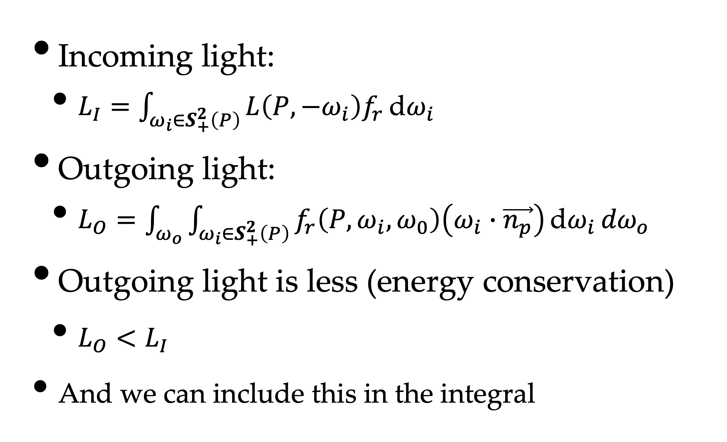
Incoming vs. Outgoing
Incoming light:
$L_{I}=\int_{ω_{i}∈S_{+}^{2}\left(P\right)}^{ }{L\left(P,−ω_{i}\right)f_{r}}\text{d}ω_{i}$
Outgoing light:
$L_{O}=\int_{ω_{o}}^{ }{\int_{ω_{i}∈S_{+}^{2}\left(P\right)}^{ }{f_{r}\left(P,ω_{i},ω_{0}\right)\left(ω_{i}∙\vec{n_{p}}\right)}\text{d}ω_{i}}{dω}_{o}$
Outgoing light is less (energy conservation)
$L_{O}<L_{I}$
And we can include this in the integral

Slide 24
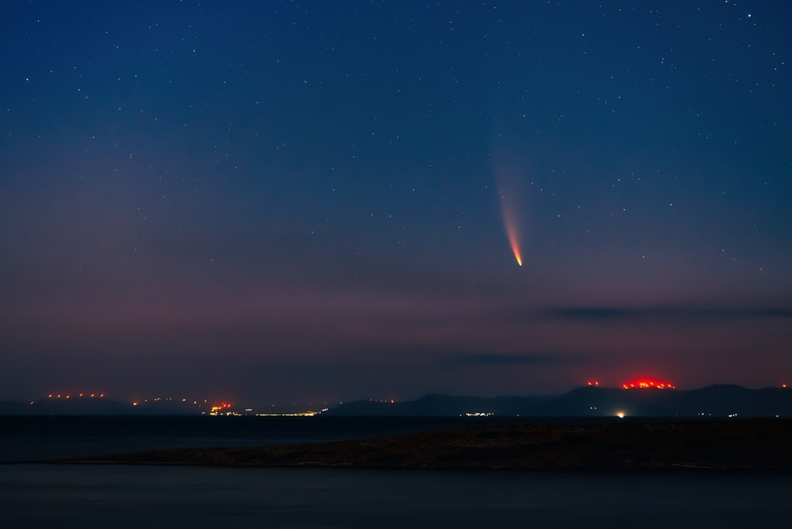
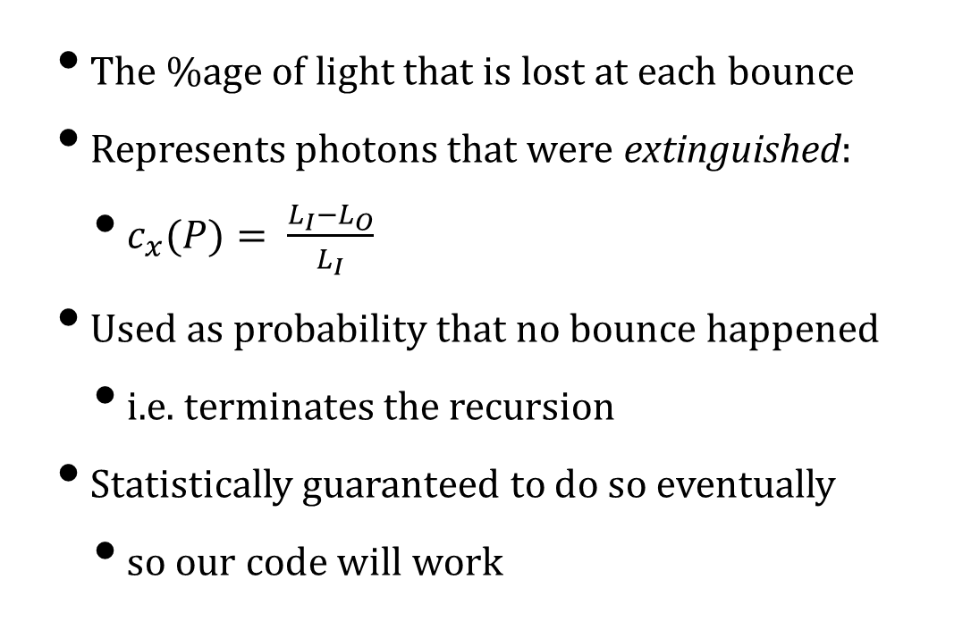
Extinction Coefficient
The %age of light that is lost at each bounce
Represents photons that were extinguished:
$c_{x}(P)= \frac{L_{I}−L_{O}}{L_{I}}$
Used as probability that no bounce happened
i.e. terminates the recursion
Statistically guaranteed to do so eventually
so our code will work

Slide 25
Extinction Code

Slide 26
Recursion
We invoke pathTrace recursively
Each bounce generates more rays
But eventually all rays terminate
Due to extinction coefficient (the base case)
However, this is why the large run times
Real-time rendering is about optimising this

Slide 27
Simple Optimisation
At every bounce, light attenuates
I.e. less of it carries forward
So pass that percentage into the recursion
Terminate when it drops below a threshold
e.g. 0.0001

Slide 28
Albedo Termination

Slide 29
Albedo Termination

Slide 30
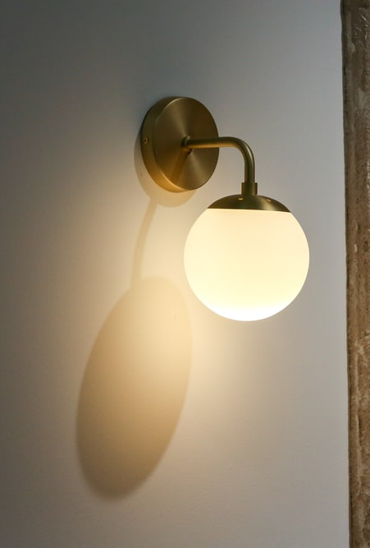
Area Luminaires
Each point on the surface of the light emits
We want to integrate over this area
Even if it has a funny shape
Solution: Monte Carlo simulation
Buried in Luminaire::Position
The sampling takes care of the integration

Slide 31

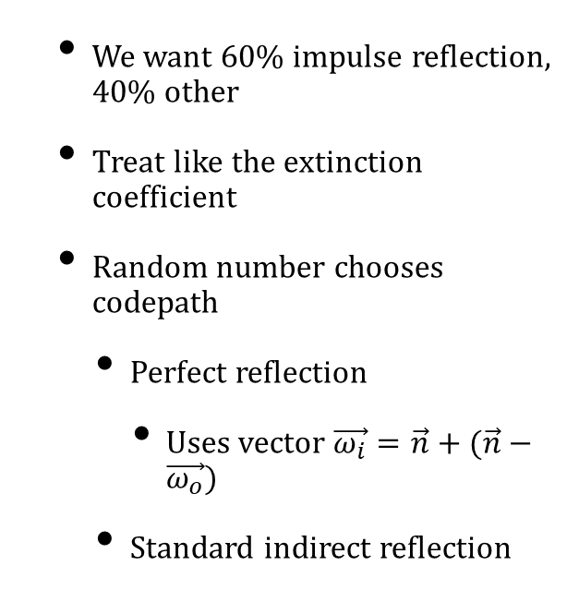
Impulse Reflection
We want 60% impulse reflection, 40% other
Treat like the extinction coefficient
Random number chooses codepath
Perfect reflection
Uses vector $\vec{ω_{i}}=\vec{n}+(\vec{n}−\vec{ω_{o}})$
Standard indirect reflection

Slide 32
Impulse Reflection Code

Slide 33

Adding Transmission
Substitute a scattering equation
$L^{r,out}\left(P,ω_{o}\right)= \int_{ω_{i}∈S^{2}\left(P\right)}^{ }{L^{in}\left(P,−ω_{i}\right)f_{s}\left(P,ω_{i},ω_{0}\right)\left|ω_{i}∙\vec{n_{p}}\right|}\text{d}ω_{i}$
Integrates over all incoming directions
BRDF becomes BSDF
dot product now has absolute value
and we add in, out annotations

Slide 34
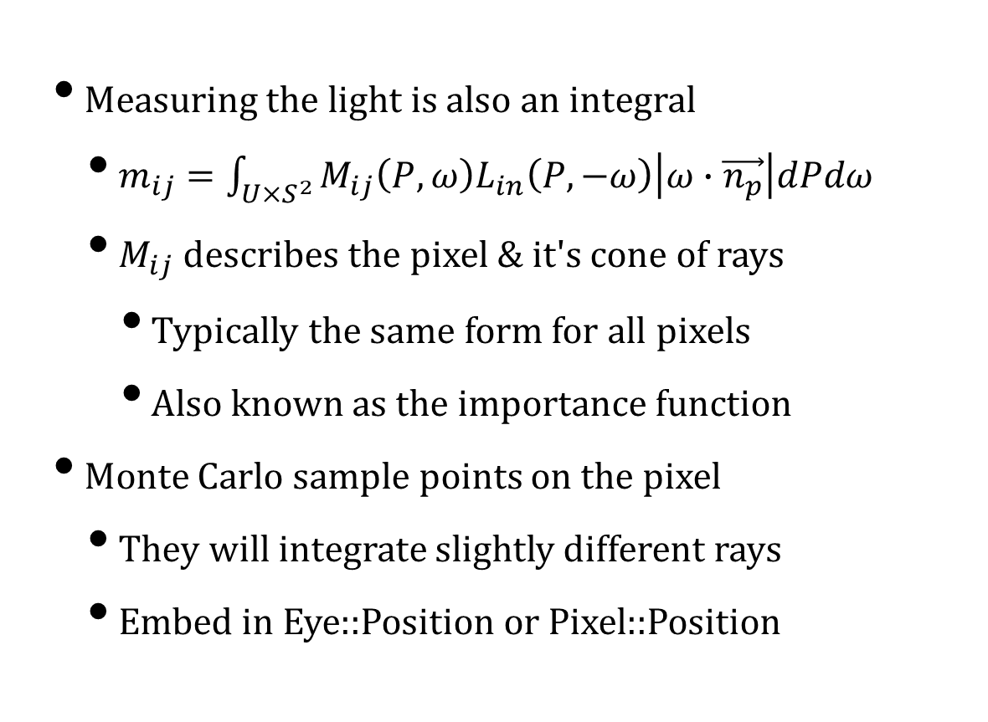
Sensor Modelling
Measuring the light is also an integral
$m_{ij}=\int_{U×S^{2}}^{ }{M_{ij}\left(P,ω\right)L_{in}\left(P,−ω\right)\left|ω∙\vec{n_{p}}\right|dPdω}$
$M_{ij}$ describes the pixel & it's cone of rays
Typically the same form for all pixels
Also known as the importance function
Monte Carlo sample points on the pixel
They will integrate slightly different rays
Embed in Eye::Position or Pixel::Position

Slide 35
Images by
S7 Martin Lostak
S24 Tasos Mansour
S30 Giorgio Trovato
S31 Pat Whelen

